Slide 1

MTN-025 (HOPE) Training
Laboratory: HIV Testing
Urvi Parikh, PhD.
Associate Director, MTN Virology Core Lab
University of Pittsburgh
Pittsburgh, PA

Slide 2
Overview
HIV Tests
  Fourth Generation Rapid Tests
  Geenius Confirmatory Test
Review of HOPE HIV Algorithms
  Screening
  Follow-Up
New HIV Testing Notification and Query Form

Slide 3
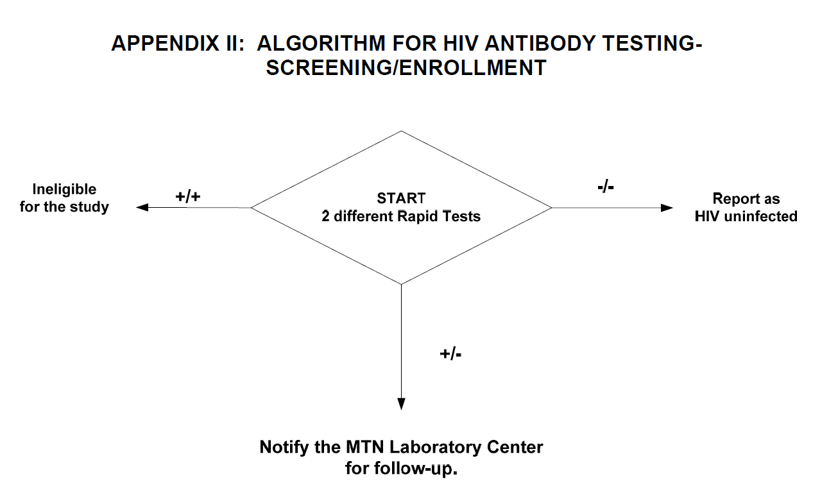
MTN-025 Testing Algorithm
Screening/Enrollment

Slide 4
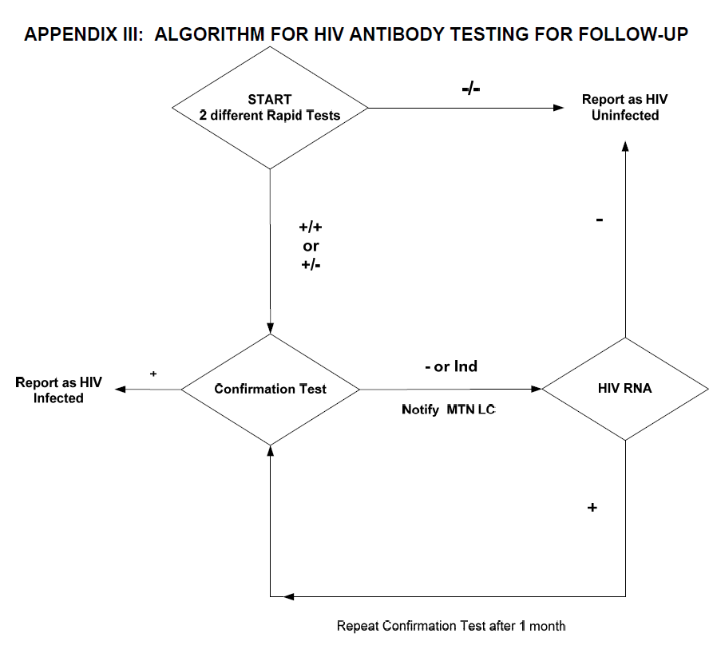
MTN-025 Testing Algorithm
Study Visits/Endpoint

Slide 5
PART I.
New HIV Rapid and Confirmatory Tests

Slide 6
Fourth Generation Rapid Tests

Slide 7
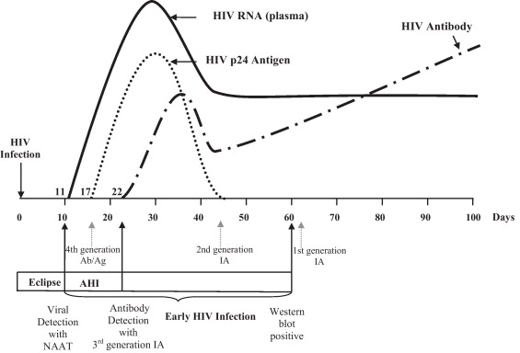
Detection of HIV Infection with Current Tests
Patel et al. J Clin Virol. 2012

Slide 8
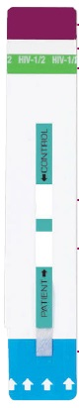

3rd and 4th Generation HIV Tests
4th generation
3rd generation
Detects infection as defined by the presence of antibody AND/OR ANTIGEN.
Detection at antigen 2-3 weeks after infection.
Detects infection as defined by the presence of antibody.
Detection at 3-4 weeks after infection.

Slide 9
Alere HIV Combo 4th gen. Rapid Test
Antibody Window
Control Window
Sample Pad
ANTIGEN window
Biotinylated anti-p24 antibodies and selenium colloid – conjugates coated with:
HIV-1, HIV-2 and group O antigens, synthetic HIV-2 peptide
Anti-p24 monoclonal antibody
Immobilized HIV-1/ HIV-1 group O antigens and synthetic HIV-1/HIV-2 peptides
Immobilized avidin

Slide 10

4th Generation Rapid Test Kits
MAKE SURE YOU ARE USING THE CORRECT 4TH GEN RAPID TEST KIT !

Slide 11
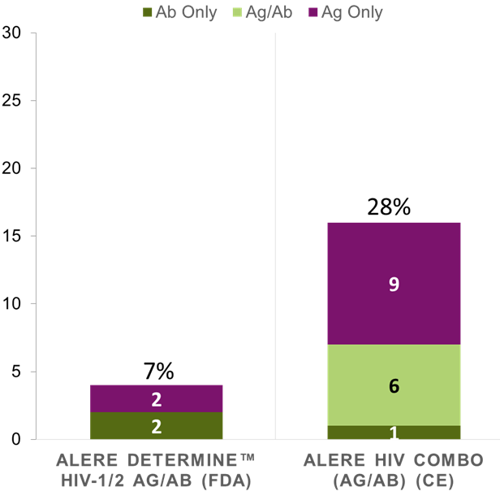
4th Generation Rapid Test Kits
Proportion of RNA Positive/3rd Gen Rapid Neg Samples Detected as HIV Positive by 4th Gen Rapid Tests
There is a significant difference in ability to detect acute infection with the Determine Ag/Ab kit compared to the Combo kit
All 4th gen rapid kits are not the same.
Number Positive
Livant, CROI 2016

Slide 12


4th Generation Rapid Test Kits
Alere HIV Combo
(Purple Strips)
Alere Determine HIV-1/2 Ag/Ab Combo
(Aqua/Blue Strips)
Remember
Both kits have the word “Combo” in it.
Do not use the one called “Determine”

Slide 13
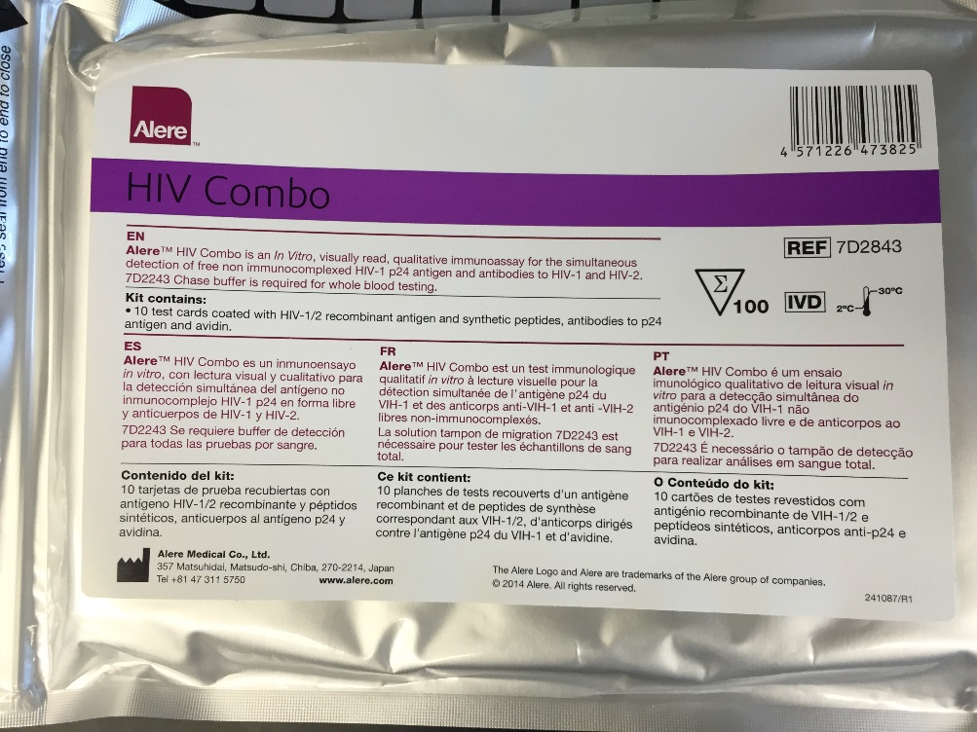
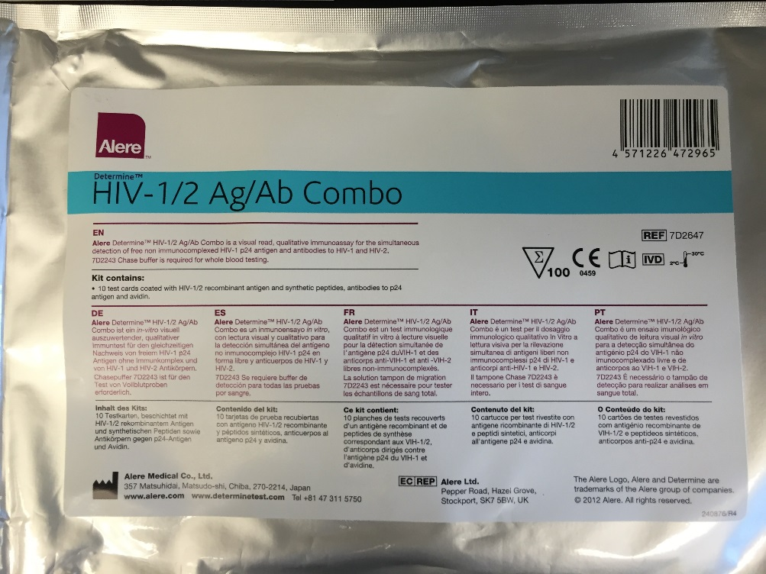


4th Generation Rapid Test Kits
CORRECT KIT
DO NOT USE THIS!

Slide 14
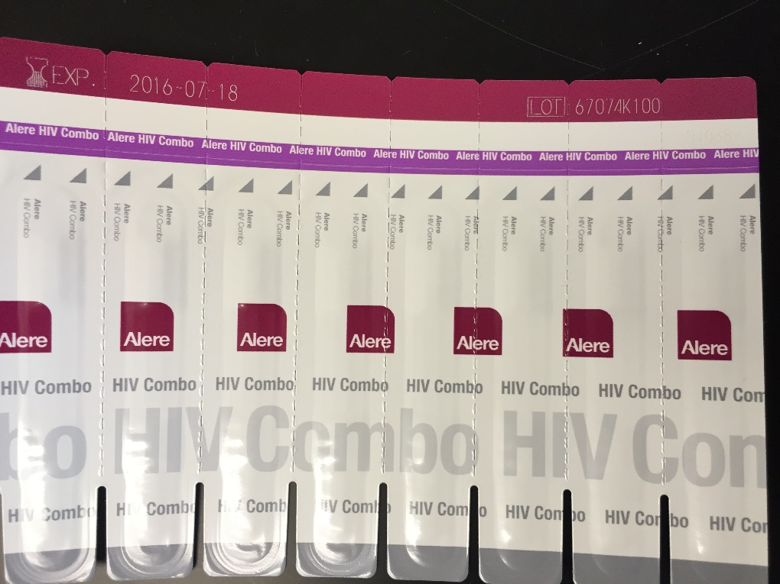
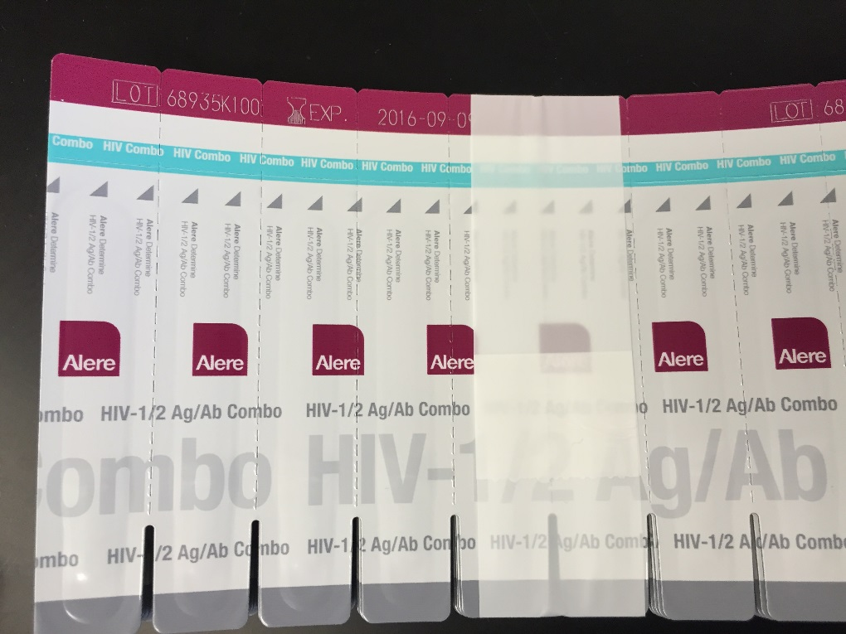
4th Generation Rapid Test Kits
YES
NO

Slide 15
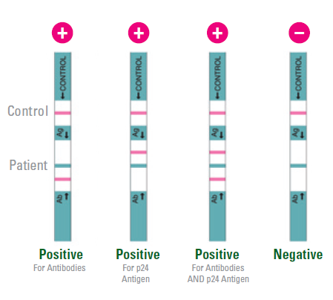
HIV Combo Results Interpretation

Slide 16
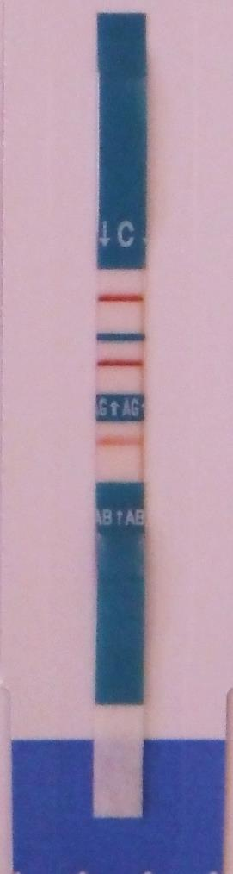
Ag or Ab Band
Test has 3 windows.
Control window must have a band
Result is positive if there is a band of any intensity in the antigen OR antibody window

Slide 17
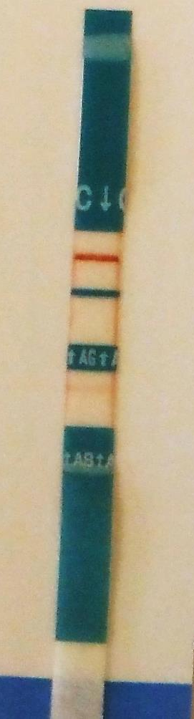
Faint Bands
ANY present test line should be reported as ‘Positive’, regardless of its intensity.
Faint bands should still be considered positive
All positive results will be confirmed by Geenius and/or RNA
Control band
No Ag band
Faint Ab band

Slide 18
Discordant Rapids
Rapid test discordance may occur more frequently when using one 3rd and one 4th gen. rapid test:
Why?
  Participant is in the acute HIV infection phase (only HIV p24 antigen is detectable at this time)
  One test may be more sensitive in its ability to detect antibodies to HIV than the other.
What to do?
  Follow testing algorithm and continue with the Geenius confirmatory test and HIV RNA
  Familiarize yourself with counseling messages following discordant results

Slide 19
Geenius Confirmatory Test

Slide 20
Geenius Confirmatory Assay
Test cassette
Geenius Reader
The Geenius Reader MUST be used to read the Geenius cassette result for MTN studies.

Slide 21
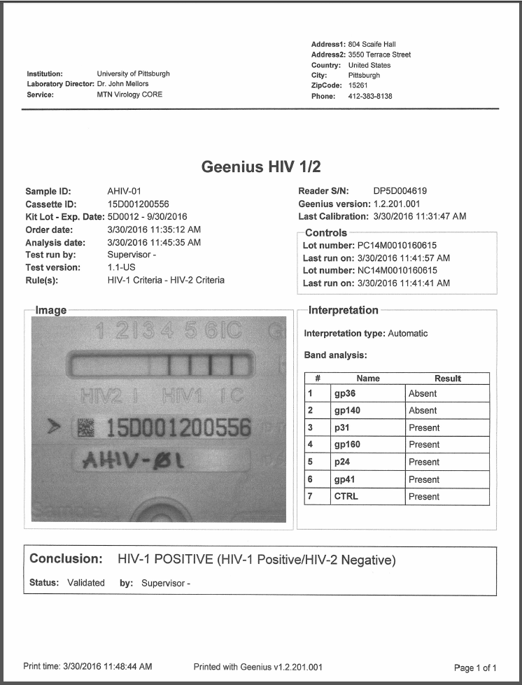
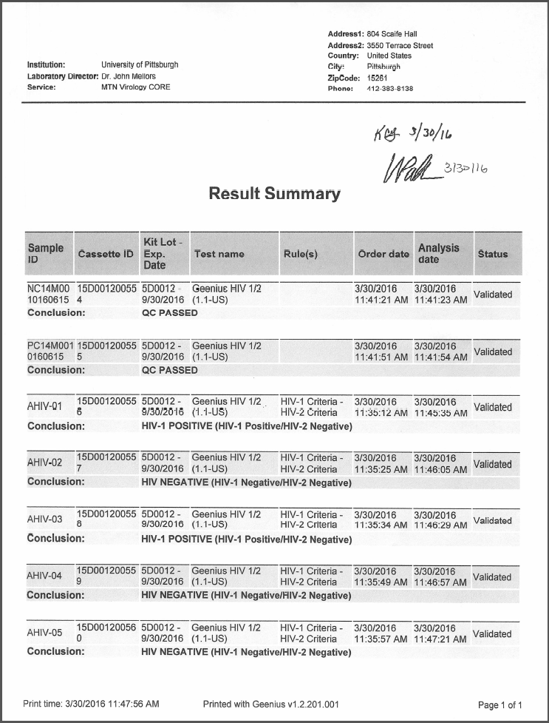
Geenius Patient Report and Data
Print report for participant care
Result summary for lab.
Also store .csv file electronically.

Slide 22
Geenius Result Possibilities
HIV-1 positive
HIV-negative
HIV-1 indeterminate
HIV-2 positive
HIV-2 indeterminate
HIV-2 positive with HIV-1 cross-reactivity
HIV untypable
Most Common
Rare but Could Occur

Slide 23
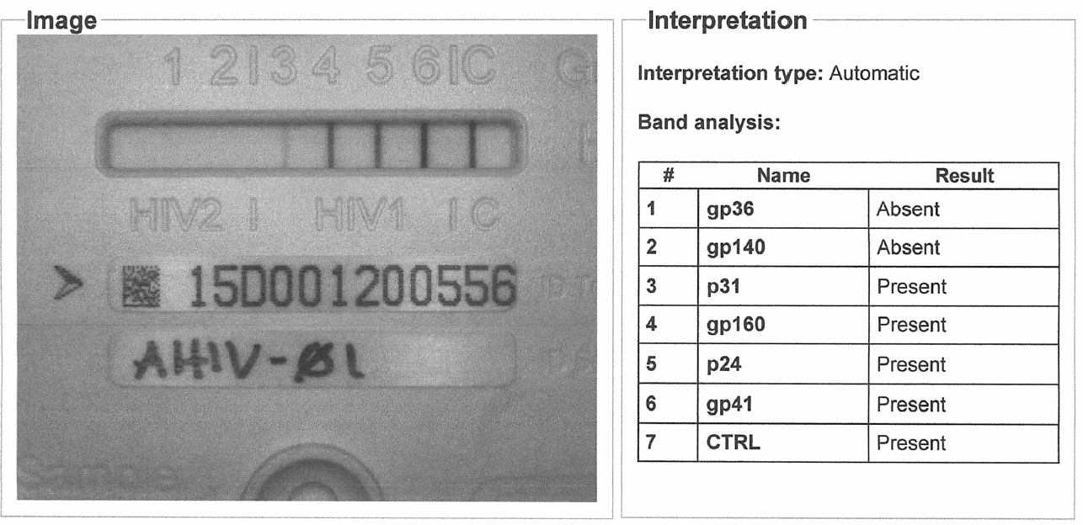
Geenius Reader Issues
Make sure bands seen on cassette match interpretation by machine.
Report any inconsistencies to LC

Slide 24
HIV-2 Results
HIV-2 is a different virus than HIV-1
HIV-1 RNA PCR (Roche TaqMan or Abbott M2000) cannot be used to confirm HIV-2 infection.
HIV-2 is uncommon in sub-Saharan Africa and there have been zero cases of HIV-2 infection to date in seroconverters from HPTN-035, VOICE and ASPIRE
Notify LC for further guidance

Slide 25
HIV Combo and Geenius Discordant result
Scenario: Geenius does not confirm an HIV Combo Positive sample.
  This is a likely scenario if the sample was originally only ANTIGEN positive.
Action: Follow testing algorithm → Perform HIV RNA PCR and prepare an MTN HIV testing query form.

Slide 26
PART II.
HOPE HIV Screening and Follow-Up Algorithms

Slide 27
MTN-025 Testing Algorithm
Screening/Enrollment

Slide 28
Screening/Enrollment
Sites will use two rapid HIV tests at screening and enrollment:
  Fourth generation CE Marked Alere Combo
  A third generation FDA-approved test.
If both rapids are negative,
the participant will be considered HIV-uninfected.
If both rapids are positive,
the participant will be considered HIV-infected.
  Follow-up is local standard of care and site discretion to do extra tests

Slide 29
Screening/Enrollment
If rapids are discordant…
(one positive and one negative)
Inform the MTN LC by submitting a query form.
The LC will respond in 24 hours, but do not wait for a response.
  Immediately collect blood
  Perform a Geenius confirmatory test
  Perform or send for plasma viral load (HIV RNA PCR)
  IMPORTANT: the participant has not completed enrollment procedures, so blood or plasma may not be stored for future testing at this time.

Slide 30

Special Circumstances
Enrolling participants who have discordant rapid test results who confirm as HIV negative is permitted
Please notify LC using the Query Form

Slide 31
MTN-025 Testing Algorithm
Study Visits/Endpoint

Slide 32
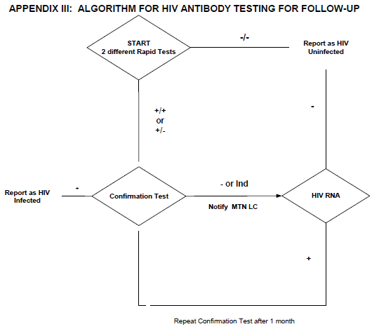
Testing Algorithm Differences
Study Visits/Endpoint
ASPIRE
HOPE

Slide 33
Follow-Up
Sites will use two rapid HIV tests at follow-up:
  Fourth generation CE Marked Alere Combo
  A third generation FDA-approved test.

Slide 34
Follow-Up
If both rapids are negative,
the participant will be considered
HIV-uninfected.

Slide 35
Follow-Up
If both rapids are positive,
the participant will be considered HIV-infected.
Conduct a new blood draw on the same day for CD4, viral load (HIV RNA PCR) and plasma storage.
  If the site is unable to collect the sample because the participant is unwilling or other reason, they should try to recall the participant as soon as possible
Perform the CE-marked Geenius confirmatory assay
Perform or send for HIV RNA PCR

Slide 36
Follow-Up
If rapids are discordant…
(one positive and one negative)
Follow procedures identical to those after two positive rapids.
Collect blood from a separate blood draw on the same day and proceed immediately with Geenius testing, CD4, and HIV RNA viral load at the local lab.
Notify the MTN LC using the query form
  However, do not wait for MTN approval or MTN LC response to the query form to proceed with further testing

Slide 37
Confirmatory Testing
If the Geenius is positive, HIV infection is considered confirmed for study purposes per the algorithm.

Slide 38
Confirmatory Testing
If the Geenius is negative or indeterminate
  Notify the MTN LC using the query form
  Use the results of the HIV RNA viral load to determine the need for further testing.
Viral Load Result | Final Status
≥20 copies/mL (TaqMan) or ≥40 copies/mL (M2000) | HIV-infected
“Target not detected” | HIV-uninfected
“Detected, below the limit of detection” | Further testing may be needed Contact MTN LC

Slide 39
Repeat Testing
When collecting blood to repeat Geenius, even though seroconversion is not yet confirmed at this point, collect additional blood for post seroconversion sample testing (CD4, RNA and plasma storage) along with the repeat Geenius.
Testing for the RNA and CD4 should proceed immediately.

Slide 40
No more DNA testing?
We never did DNA testing in ASPIRE
If it is ever needed, we can request a new sample draw
  for example, if Geenius is indeterminate with one major band such as p24, and HIV RNA viral load is detected but below the limit of detection.
Samples for DNA testing can only be collected with approval from the MTN LC.

Slide 41
Acute Infection
During follow up, participants
who request an HIV test at an interim visit
or report a risk exposure
should have HIV RNA PCR performed
even if they have 2 negative rapid test results

Slide 42
PART III.
HIV Testing Notification and Query Form

Slide 43
MTN HIV Testing Notification and Query Form
New form layout and usage
The form can now be used either a testing query (as in ASPIRE) or as simply a notification to the LC.
No longer need to specify kit lots and expiration dates on the form.

Slide 44
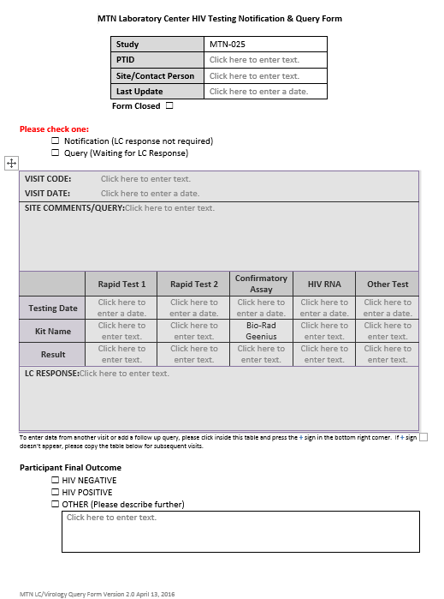
When to Use the Query Form
Discordant rapids
Neg or Ind Geenius
HIV-2 result
Unusual test pattern
Acute infection
Any HIV testing case that requires assistance from MTN LC

Slide 45
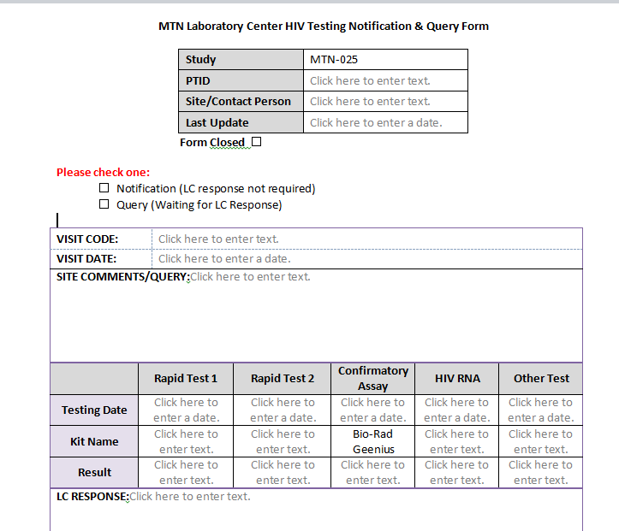
New Features
Form Closed
LC will tick this box when query is complete.

Slide 46
New Features
Notification: Tick this box when a site is required to notify LC of a result as described in the follow-up algorithm but the site can continue testing without LC guidance
Query: Tick this box when LC guidance is needed for further testing or to resolve HIV status.
→ The LC will aim to provide a response within 24 hours
→ Please contact the LC if a response is not received within 48 hours

Slide 47
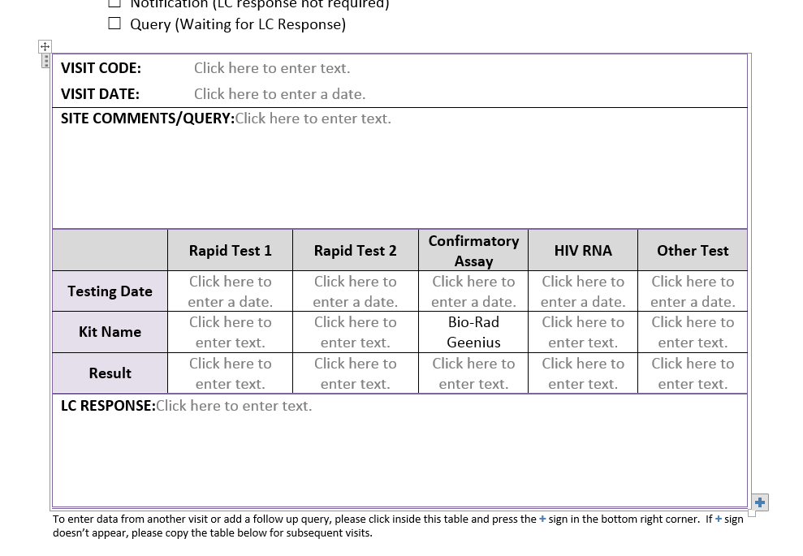
New Features
Office 2010 and earlier versions: copy paste table to add more data from additional visits
Office 2013 and later versions: press + to add new data table

Slide 48
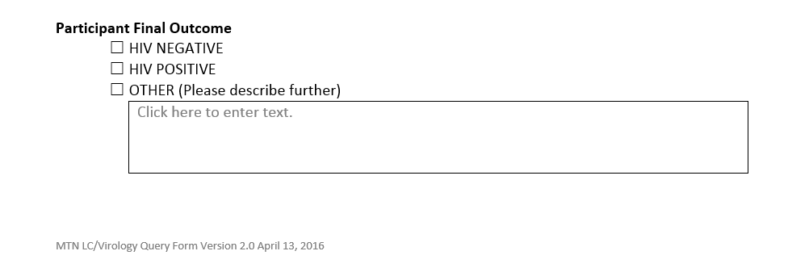
New Features
Participant Final Outcome
Tick “Other” if unknown or suspected HIV-2

Slide 49
Send Query Form to MTN LC
Email query form to:
  mtnvirology@mtnstopshiv.org
MTN LC will respond and reply to query with comments directly on form
Continue using same form for new information for same PTID
When “Query Closed” box is ticked, form can be filed.

Slide 50
References
MTN Virology Core
mtnvirology@mtnstopshiv.org
MTN-025 SSP Section 13: Laboratory Considerations
http://www.mtnstopshiv.org/node/7334
Contacts at MTN LC and Virology Core
Urvi Parikh, Ph.D. ump3@pitt.edu
Amy Opest, M.S. amo45@pitt.edu
Edward Livant, BSMT(ASCP), MPH elivant@mwri.magee.edu

